Slide 1

Authorization in Microservice / Distributed Systems
Halil İbrahim Kalkan
https://github.com/hikalkan/presentations

Slide 2

Agenda
Authentication & Authorization
Authorization Types & Requirements
Architectural Discussions
Solutions and Tradeoffs

Slide 3
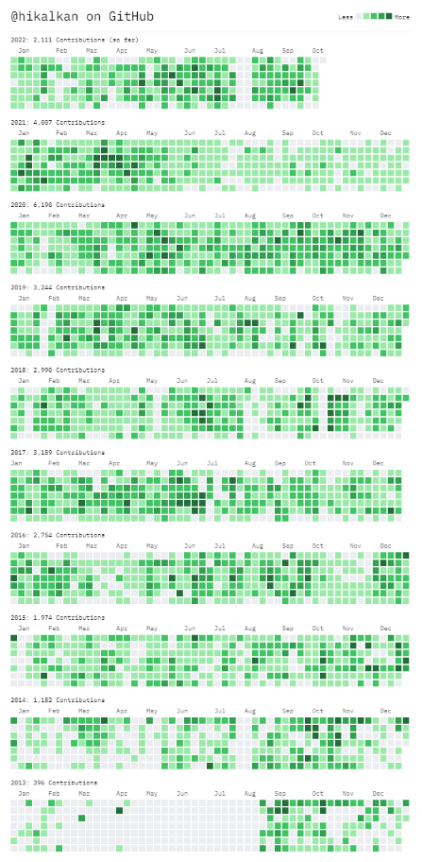






About Me: Halil İbrahim Kalkan
2007, Computer Engineering, Sakarya University
2007 - 2015: Software developer, software architect, team leader
2016 - ∞: Co-founder, software architect
2013 - ∞: Lead developer of the open source ABP Framework
Multi-threading, distributed systems, OOP, DDD, software architectures.. etc.
Highly active coder, mostly open source.

Slide 4
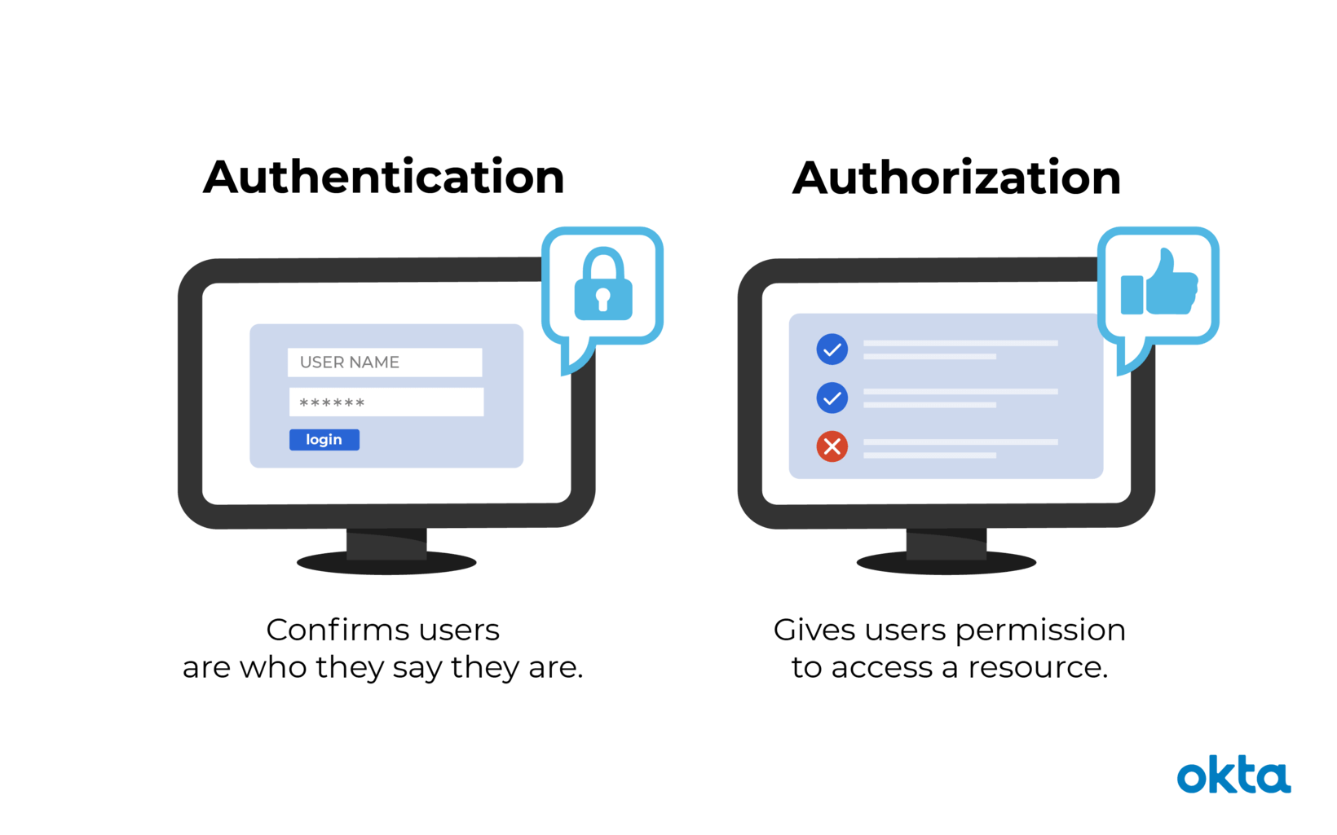
Authentication vs Authorization
Image source: https://www.okta.com/identity-101/authentication-vs-authorization/

Slide 5

Authentication The Authorization Code Flow
Web Application
Needs authentication
Access token
Authorization code
Token
request
Id Token
Access Token
API Gateway
browser
Access token
Authorization code
validation
Microservices
Redirects
Authentication Server (The Authority)
(Login & Consent UI)

Slide 6
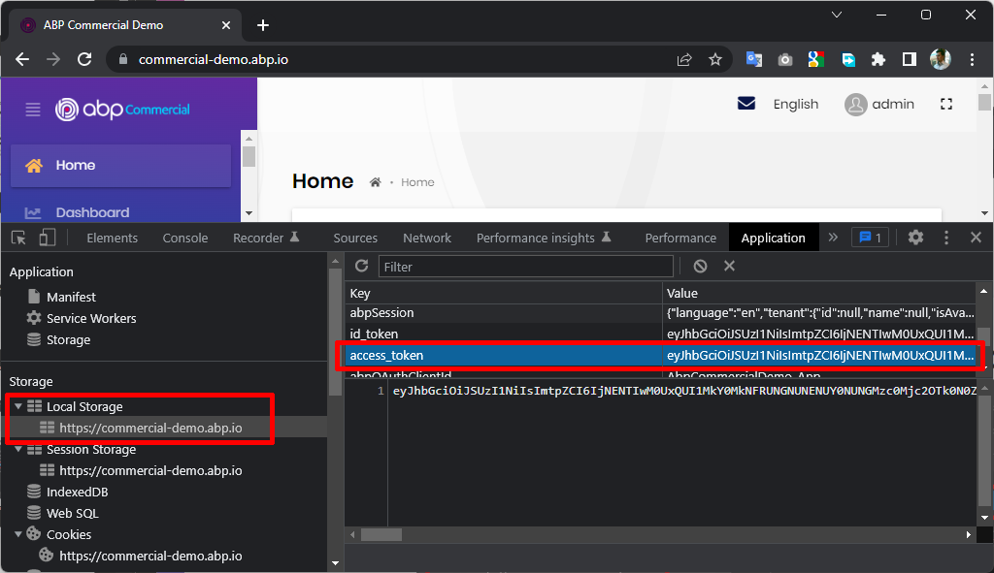
Authentication Storing the Access Token

Slide 7
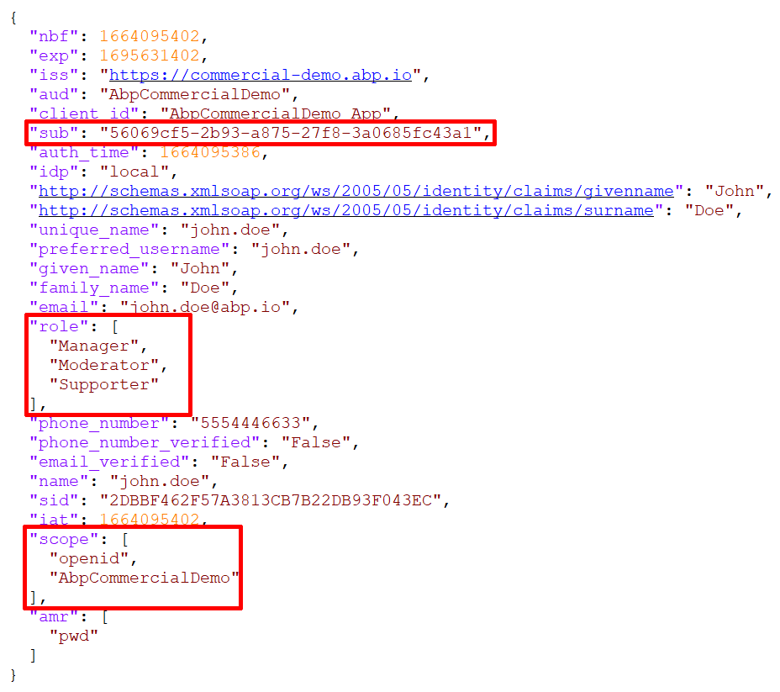
Authentication The Access Token
Standard claims
Sub: User Id
Role: Roles of the user
Scope: Allowed scopes
And your custom claims

Slide 8
Authorization Types
Claims based
On/off style permissions (typically user and role based)
Check a permission database
Custom policies
Check permission database & apply custom logic
Resource based
Check permission database & apply custom logic based on the requested resource

Slide 9
Authorization Resource based policy
Can a user or client X do an operation Y on a resource Z?
Can current user (X) edit (Y) a product (Z) information?
Do not allow if product is locked
Allow if the product was created by the user
Allow if the user has permission to edit products (permissions are managed by admin users)
Allow if any of user’s roles has permission to edit products
Only allow if the user is working in the department the product belongs to

Slide 10
Authorization Components
Where to force authorization? PEP: Policy Enforcement Point
In the API Gateway? In the current service?
Where to perform the authorization logic? PDP: Policy Decision Point
In the current process? In a dedicated service?
Where and how to obtain the data to perform the authorization logic? PIP: Policy Information Point
Direct database access? Collect on-demand? Pre-duplicate?
Where and how to manage policies and permissions? PAP: Policy Administration Point
Typically, on a user interface

Slide 11
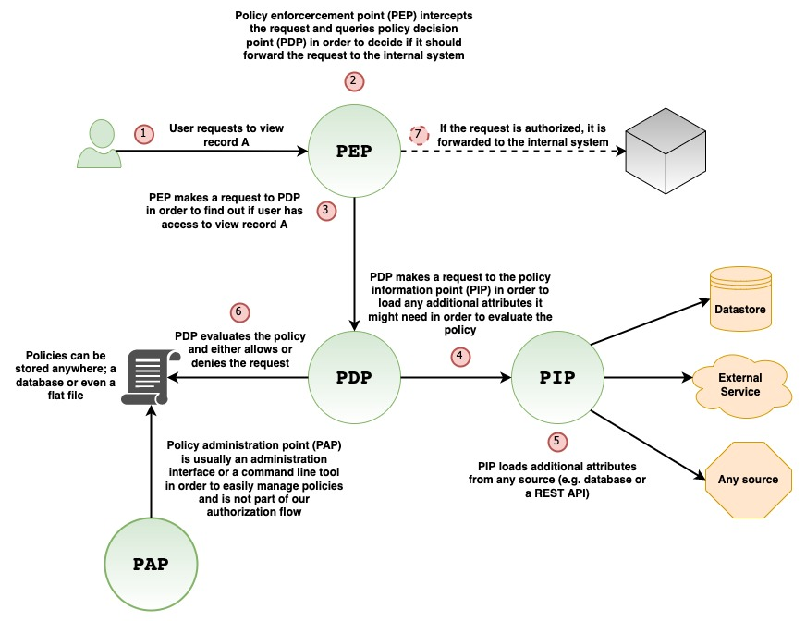
Image source: https://www.alexanderlolis.com/authorization-in-a-microservices-world#authorization-flow-overview

Slide 12
Authorization
Client Application
HTTP Request
with access token
Permissions / Authorization Data & Logic
Administration Application
Your HTTP API / Microservice
Database
Other Resources

Slide 13
Discussion: External Authorization Service
How to obtain the application data?
Directly read from service’s database?
Send data on the authorization service call?
Pre-duplicate the data into authorization service’s database?
Other problems:
Network delays / problems on authorization service call.
Authorization service become a bottleneck.
Client App
API Gateway
Microservice
Service
Database
PEP
Authorization Service
Permissions
Database
PDP
?PIP?

Slide 14
Discussion: Check on API Gateway
Advantages:
Decouple authorization logic from the microservice
Prevent microservice call for unauthorized requests
Disadvantages:
Requires custom logic in API Gateway – restricts gateway technology selection
Maps permissions with HTTP details
Can only know the HTTP request details (like route & HTTP method)
Client App
API Gateway
Microservice
Service
Database
PEP
Authorization Service
Permissions
Database
PDP
?PIP?

Slide 15
Discussion: Authorization Library
Advantages:
Decouple authorization logic from the microservice logic
Application data is available
Custom authorization logic is possible
Disadvantages:
Can be a problem if you have microservices developed with different platforms (.NET, Java, Phyton…)
Client App
Microservice
Authorization
Library
Service
Database
API Gateway
PEP + PDP + PIP
Permissions
Database

Slide 16
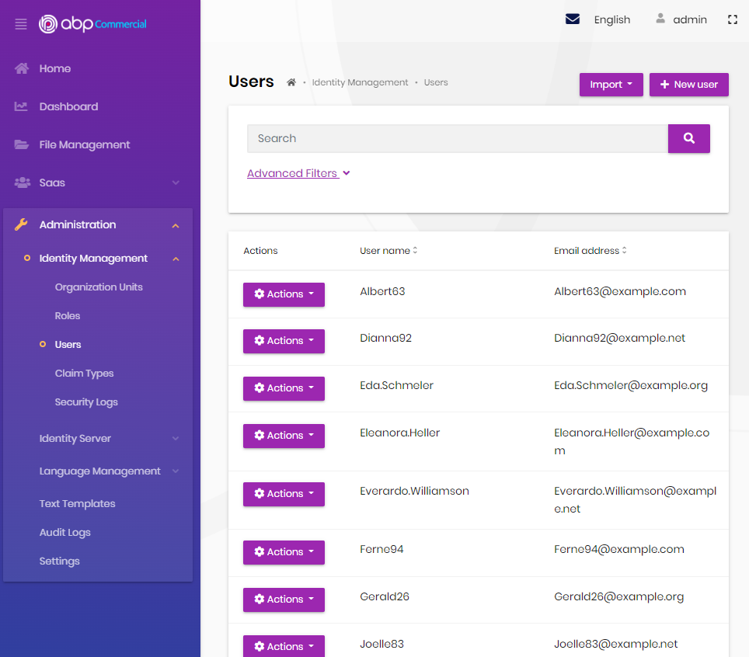
User Interface Check All Permissions
Get a list of all granted permissions of the current user!
Why we need it?
Show / hide menu items, headers, toolbars, etc.
Show / hide UI parts, buttons, etc.
To check the permissions on the client-side for a SPA

Slide 17
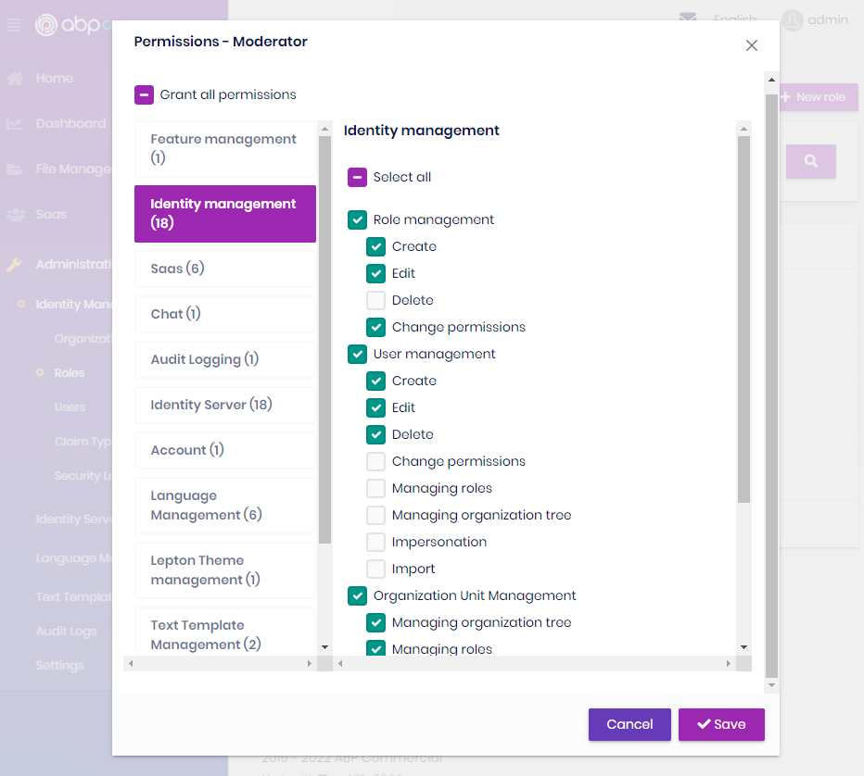
Administration Manage All Permissions
Show and manage all the permissions for a role or user.
Why we need it?
To manage permissions in a single place in the application.

Slide 18
Storing Permission Data
Every microservice have their own permission tables in their own databases?
Hard to manage (load and save) permissions
Hard to get all permissions
Too much responsibility to the service
A central permission database?
All services directly connects to that database over an authorization library.

Slide 19
Check/Manage All Permissions: How?
Ask to all microservices on demand?
Problems: Service discovery, performance, too much load on the services, hard to manage (change) permissions
Calculate all permissions in microservices and pre-cache in a central place?
Very hard to manage and refresh such a cache (an arbitrary data change may affect many users’ permissions), the cache would be too big
Calculate permissions in a central place, in a permission management service?
Ideal for on/off style permissions with minimal dependencies to microservice internals

Slide 20
Inter-microservice authorization
Option #1: No authorization
Define different endpoints for inter-microservice communication & restrict access out of the API Gateway!
Use the same endpoints, allow access based on a custom HTTP header.
Options #2: Authorize
Pass access token in service calls
Re-authenticate via client credentials flow and manage client permissions
User-context available operations vs background tasks
Client App
API Gateway
…
Microservice A
Microservice A
Authorization?

Slide 21
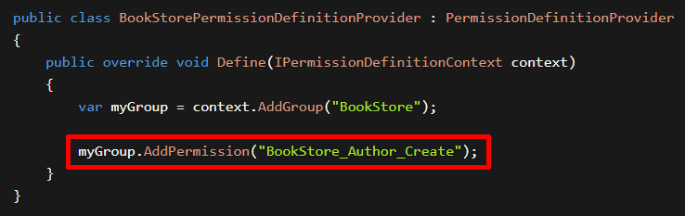
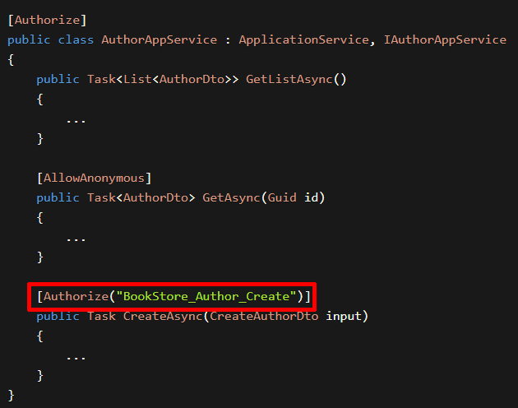
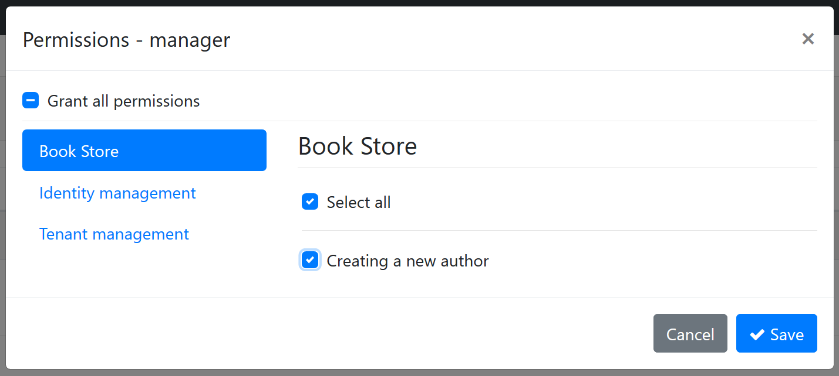
ABP: Permission Management
(1) Define Permissions
(2) Check Permissions
(3) Grant Permissions

Slide 22
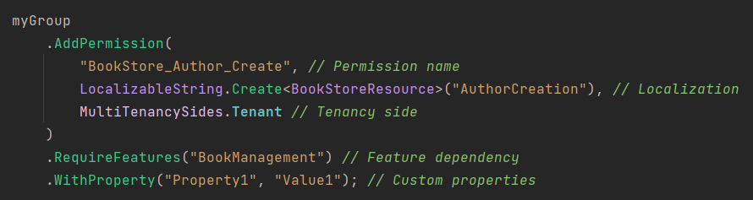
ABP: Permission Definition
Permission name
Localized permission display name
Other dependencies: features, global features
Custom data

Slide 23
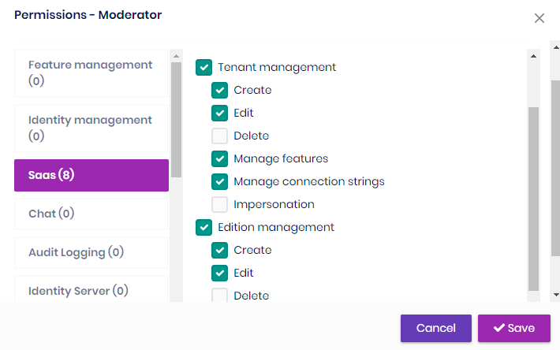
ABP: Permissions in Microservices
Microservice 1
Permission A, B
ABP Authorization Library
The Permission Management UI
Permission Management Database
Microservice 2
Permission C, D, E
ABP Authorization Library
Permission Management Microservice
Permission Groups Permission Definitions
Permission Grants
ABP Authorization Library

Slide 24
ABP: Updating Permission Definitions
On the service startup;
Calculate a single hash of all permission definitions
Compare with the hash in the distributed cache
Serialize and save permission definitions (only changed / new ones)
Update the permission stamp to inform other services
Use microservice name as a cache key prefix
Microservice A
Distributed Cache
Static Permission Definitions
calculate
compare
hash
ms_A_hash
update
perm_stamp
Serialize & save permission definitions
Permission Management Database

Slide 25
ABP: Getting Permission Definitions
On demand;
Check permission cache stamp & use in-memory cache if up to date
With frequency control (30 seconds)
Get & deserialize permission definitions if different
On the service startup;
Pre-cache permission definitions
Permission Microservice
Distributed Cache
Static Permission Definitions
Dynamic
Permission Store
In-Memory Cache
Check cache stamp
perm_stamp
perm_stamp
Permission Management Database
Get & deserialize permission definitions

Slide 26
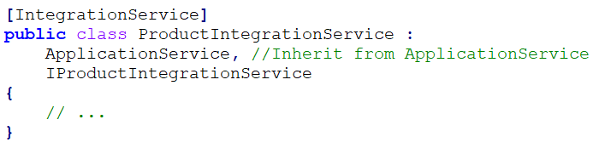
ABP: Integration Services
Introduced the [IntegrationService] attribute
Default HTTP API URL prefix: /integration-api/… instead of /api/…
Audit logging is disabled by default, but can be enabled

Slide 27
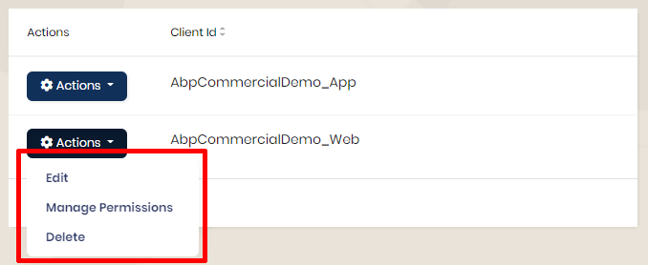
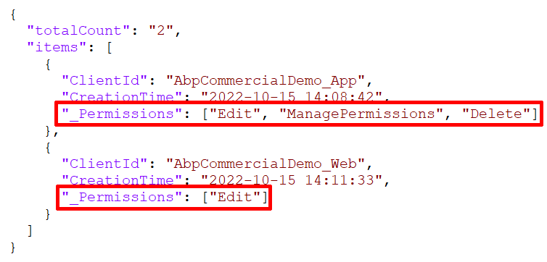
Resource Based Permissions

Slide 28
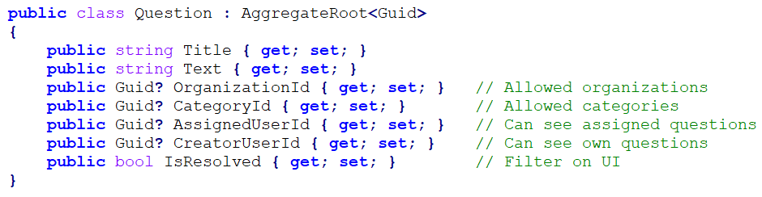
Querying with Permissions
Need to get a list of resources (entities), filtered based on business rules, user preferences and permissions.

Slide 29
Pre-built authorization systems
Examples:
Casbin An authorization library that supports access control models like ACL, RBAC, ABAC
Cerbos Open source, decoupled access control for your software
Keycloak Identity and Access Management

Slide 30
Thanks!
Get This Presentation
https://github.com/hikalkan/presentations
Contact Me
Home: https://halilibrahimkalkan.com
GitHub: @hikalkan | Twitter: @hibrahimkalkan
References
Authorization in a Microservices World https://www.alexanderlolis.com/authorization-in-a-microservices-world
ABP Authorization https://docs.abp.io/en/abp/latest/Authorization
ASP.NET Core Authorization https://learn.microsoft.com/en-us/aspnet/core/security/authorization/introduction

Slide 31
Topic title
Content

